Slide 1



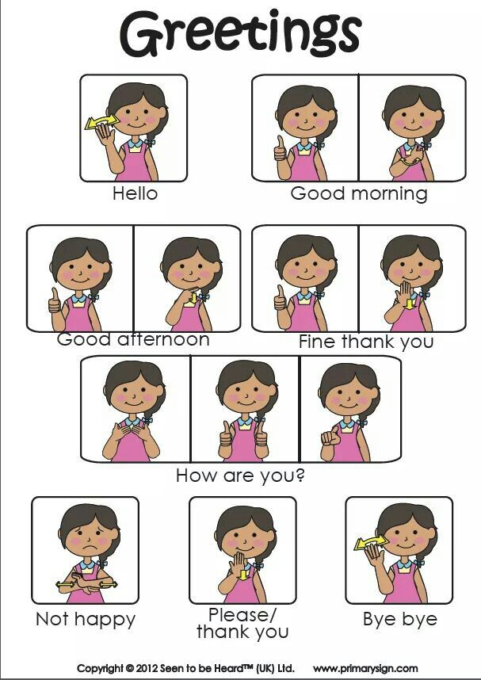
Sign Language to Text converter using Arduino
MINI PROJECT

Slide 2
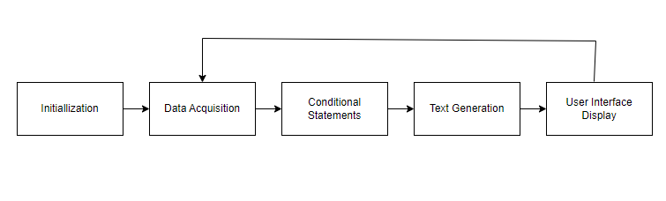
BLOCK DIAGRAM
Initialization: The system initializes and sets up the sensors, user interface, and other components.
Data Acquisition: The sensors continuously collect data on hand gestures and movements.
Conditional Statements: Based on the recognized gesture, the system uses conditional statements to determine the corresponding linguistic meaning. Each gesture is associated with specific letters or words.
Text Generation: Once the gesture is recognized and matched with the corresponding text, the system generates the text output. This text represents the sign language gesture.
User Interface Display: The recognized text is displayed on the user interface.

Slide 3
Hardware Components Used
Arduino Board: The core microcontroller board for processing the input from sensors and buttons and controlling the LCD display.
Liquid Crystal Display: Used for displaying the recognized sign language alphabet or words.
Metal Plates: Five buttons made with metal plates are used for input, representing different finger positions.
Jumper cables and wires

Slide 4
Arduino UNO
Flash Memory: The Arduino Uno has 32KB of flash memory, which is used for storing the project's code and program.
SRAM: It has 2KB of SRAM (Static Random Access Memory), which is crucial for temporarily storing data and variables during program execution.
EEPROM: The Uno includes 1KB of EEPROM (Electrically Erasable Programmable Read-Only Memory) for storing non-volatile data or configuration settings.
Input/Output Pins: It offers 14 digital input/output pins, of which six can be used as PWM (Pulse-Width Modulation) outputs, and six analog input pins. These pins are critical for connecting and controlling sensors and actuators.
Voltage Range: The Uno can be powered via a USB connection or an external power supply. It accepts a voltage range of 7-12V, which provides flexibility in power source options.
Operating Voltage: The board operates at 5V, which is compatible with many sensors and components commonly used in electronics projects.
Open-Source Software: Arduino IDE is an open-source software environment used to program the board. It supports a large community and extensive libraries, making it accessible for developers.

Slide 5
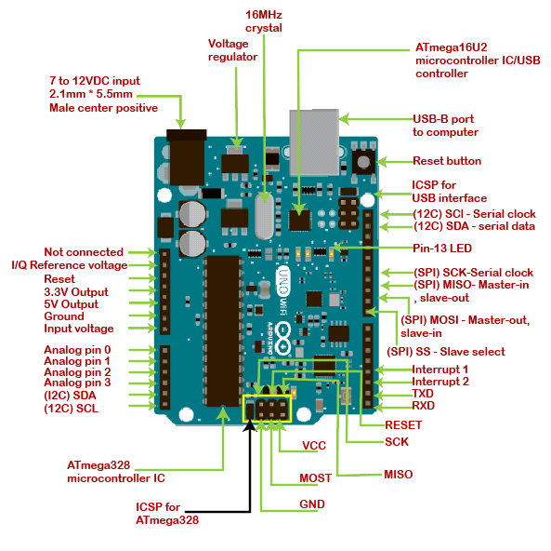
Pin out Diagram

Slide 6
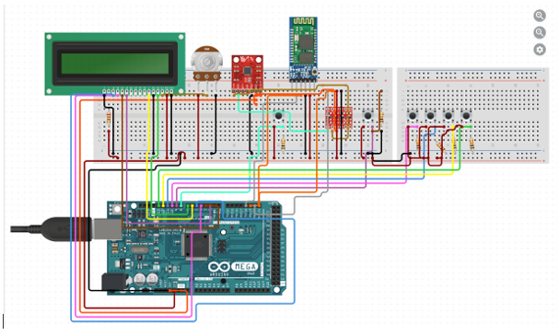
Interfacing Diagram

Slide 7
WHY ARDUINO?
Aspect | Arduino | Raspberry Pi
Power Consumption | Low power consumption | Higher power consumption
Real-time Processing | Provides deterministic real-time processing capabilities, crucial for time-sensitive applications. | Not designed for real-time processing, which might introduce delays.
Processing Power | Limited processing power, which can be advantageous for specific applications where simplicity and efficiency are key. | Offers significantly more processing power, which can be overkill for some projects and may introduce unnecessary complexity.
Customization | Customizable for specific sensor and input requirements, making it efficient for the project's scope. | Offers a wide range of capabilities, but this may lead to over-engineering for a simple project.
Use Cases | Ideal for simple embedded systems and sensor-based projects where real-time responsiveness is essential. | Better suited for more complex applications and general-purpose computing tasks.

Slide 8
Advantages of Combinational Circuit over Flex sensors
Aspect | Combinational Circuit | Flex Sensors
Cost | Generally lower cost as it uses basic electronic components. | Flex sensors can be relatively expensive.
Durability | Components in a combinational circuit can be more robust and have a longer lifespan. | Flex sensors are prone to wear and tear over time.
Calibration | Requires minimal calibration compared to flex sensors. | Flex sensors often need careful calibration for accurate results.
Maintenance | Easier to maintain and troubleshoot due to the use of discrete components. | Flex sensors might require frequent maintenance and replacement.
Wearable Applications | Suitable for wearable applications due to compact and robust design. | Flex sensors might be less suitable for wearables due to their fragility.
User Interface | Can be integrated into user-friendly interfaces and devices. | Flex sensors may require additional user training and interface complexity.
Sensing Method | Utilizes switches or sensors with clear on/off states, simplifying gesture recognition. | Flex sensors rely on variable resistance and may require more advanced algorithms for interpretation.

Slide 9
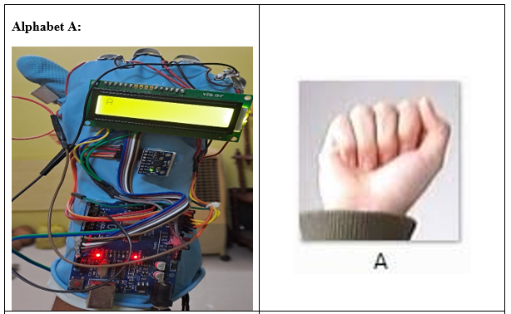
Output

Slide 10
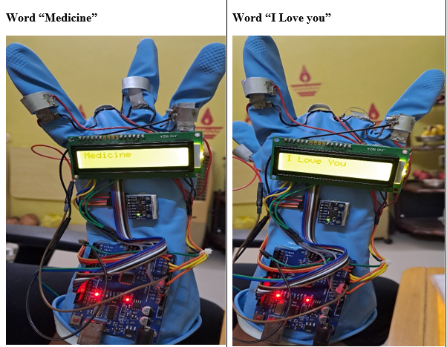

Slide 11
THANK YOU
Group Members:
Pooja Mulbagal UEC2021235
Anushka Paranjape UEC2021243
Poorva Parmar UEC2021245

